Slide 1

MGT689:
Organization Behavior and Design Theories of Management
Dr. Zvi Aronson

Slide 2
Objectives
Discuss key perspectives of Management
Implications for the HR System

Slide 3
Historical Perspectives
Efficiency is Everything
Scientific Management: Pioneered by Frederick Winslow Taylor
How to Get Organized
Classical perspective
Contributed to Bureaucratic Organizations
What about People?
Hawthorne Studies – The human relations perspective
Notes:
The modern area of management began with the classical MGT perspective in late 19 century. Once work was performed on a much larger scale, by more workers, people began thinking about how to design and manage work to increase productivity and efficiency for the firm.
The classical MGT perspective, which tried to make firms run like efficient well-oiled machines, is associated with the development of hierarchy and the bureaucratic organizations and remains the basis of much of modern management theory and practice.
Today we will review various historical perspectives including Scientific Management, the classical perspective and the human relations persepctive.

Slide 4
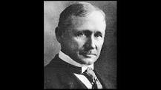

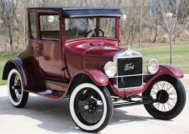
Efficiency is Everything
Scientific Management
Taylor
After years of various experiments to determine optimal work methods, Taylor proposed the following four principles of scientific management:
Replace rule-of-thumb work methods with methods based on a scientific study of the tasks.
Scientifically select, train, and develop each worker rather than passively leaving them to train themselves.
Cooperate with the workers to ensure that the scientifically developed methods are being followed.
Divide work nearly equally between managers and workers, so that the managers apply scientific management principles to planning the work and the workers actually perform the tasks.
These principles were implemented in many factories,
often increasing productivity by a factor of three or more.
Henry Ford applied Taylor's principles in his automobile factories
Families even began to perform their household tasks based on the results of time and motion studies
Drawbacks? Assumptions about human behavior?
Notes:
Drawbacks of Scientific Management
While scientific management principles improved productivity and had a substantial impact on industry, they also increased the monotony of work. The core job dimensions of skill variety, task identity, task significance, autonomy, and feedback all were missing from the picture of scientific management.
While in many cases the new ways of working were accepted by the workers, in some cases they were not. The use of stopwatches often was a protested issue and led to a strike at one factory where "Taylorism" was being tested. Complaints that Taylorism was dehumanizing led to an investigation by the United States Congress. Despite its controversy, scientific management changed the way that work was done, and forms of it continue to be used today.

Slide 5
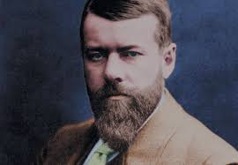
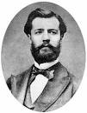

The scientific MGT focused on
designing work for employee efficiency
Classical view considered how
to efficiently structure the Org.
How to Get Organized
Clear
hierarchy &
authority
Max Weber
Detailed
Rules:
predictability
Division of
Labor:
appropriate skills
Henry Fayol
Bureaucracy
Impersonal
Treatment:
objective
standards
Lifelong
commitment
Routine task
stable environment
Assumptions about employees?
Notes:
Classical organizational theory is an early approach to the study of management (emerged during the same time that the scientific management approach) that focused on the most efficient way to structure overall organizations. The idea was that there was an efficient way to structure work in all organizations.
Two of the best know classical organizational theorists were Henry Fayol and Max Weber described in detail in your text. Weber, claimed that the ideal organizational form is the bureaucracy. This universal view of an ideal organizational structure is in contrast to the modern approaches to organizational design that stress that different forms of organizational structure may be more suited under specific conditions.
Bureaucracy is an organizational design that attempts to make organizations work efficiently by having a clear line of authority, in which people are required to perform well define jobs. This slide is a graphic presentation of the its characteristics:
Division of labor – duties are divided into special tasks and performed by those with appropriate skills
Hierarchical structure – positions are ranked by authority from lower to higher levels
Authority structure – the making of decisions is determined by one’s position in the hierarchy, higher ranking employees have the authority
Formal rules and regulations - (written) used to control employees’ behavior
Impersonal treatment favoritism – all work relationships should be based on objective standards
Lifelong career commitment – employment is viewed as a lifelong obligation on the part of the organization and the employee
Rationality – the organization is committed to achieving its goals (e.g., productivity) in the most efficient way.

Slide 6
Douglas McGregor: two distinct views of humans
Managers over a century ago tended to hold
pessimistic views about their workers
Managers have optimistic views
of employees
Theory X
Theory Y
Employees see work as a challenging
Self directed
Accept responsibility
Involved in decisions
Solve problems creatively
Meaningful work
Employees were considered lazy and Irresponsible
Seek direction
Little ambition
Involved a more authoritative approach - micromanaging people's work, constantly, & rewarding to ensure that it gets done properly
Participative management
decentralized MGT style
trust employees to take ownership and do their work effectively on their own.
More detail about the people = >
Notes:
Just a few words about Douglas McGregor that relates to our discussion.
Managers of a century ago tended to hold negative views about their workers. They assumed they were lazy and irresponsible and treated them with disrespect. This negative approach reflects a traditional view of management called Theory X. The theory Y perspective assumes that people are highly responsive to their work environments, and that the ways that they are treated will influence the ways they will act.
The next two slides list some of the differences between these two perspective also described in your text.

Slide 7
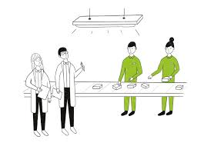
What about People? Hawthorne Studies
Human capital seen as a valued commodity Recognized existence of higher order needs as important motivators of performance. Motivators seen as both extrinsic and intrinsic, i.e the task as well as contingent rewards can motivate. The idea of integrating the needs of individuals and orgs. became a powerful force
The Hawthorn Studies (Western electric company; Mayo).
Physical environment and productivity
Illumination intensity investigation (control group); Surprising findings?
Production department – relay room; year long study (Hawthorn effect)
Only difference: research assistant was placed in the room
Employees felt management was concerned about them
Examination of sophisticated wage plan
Surprising: Workers did not maximize their outputs;
Output was controlled by a group norm
Group established what they thought was a fair output.
Other factors are influencing performance, e.g., MGT interest in workers; social norms;
This led to where Org. Design and Behavior is today, including the Human Resources System.
➔
Notes:
Early work in industrial psychology received not much attention because for the prominence of scientific management here A breakthrough occurred following a series of experiments at a Chicago electric company known as the Hawthorne studies. These studies concluded that positive treatment of employees improved their motivation and productivity.
The publications of these results led to a revolution in worker treatment and laid the groundwork for examinations of the treatment of workers, leadership, motivation and human resources management.

Slide 8

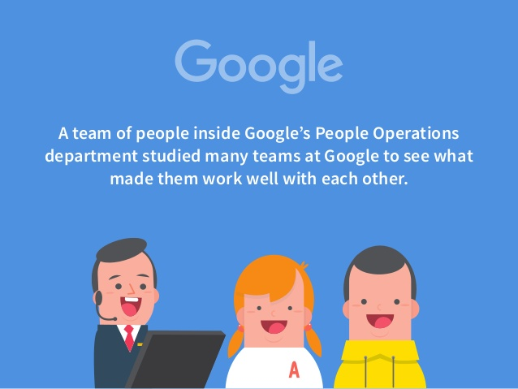
What is Human Resource Management?
The management function concerned with getting, training, motivating, and keeping competent employees
Strategic goals
Outsourcing
Small Businesses
People
Operations
Rigor to people decisions as to engineering decisions
Optimum # of interviews
Leader characteristics
1 on 1 coaching
Copyright ©2011 Pearson Education, Inc. Publishing as Prentice Hall.
63
Notes:
AON (Adler) all training and coaching for HP customer reps.
The quality of an organization is to a large degree determined by the quality of the people it employs. Success for most organizations depends on
finding the employees with the skills to successfully perform the tasks required to attain the company’s strategic goals. Staffing and human resource management decisions and methods are critical to ensuring that the organization hires and keeps the right people.

Slide 9
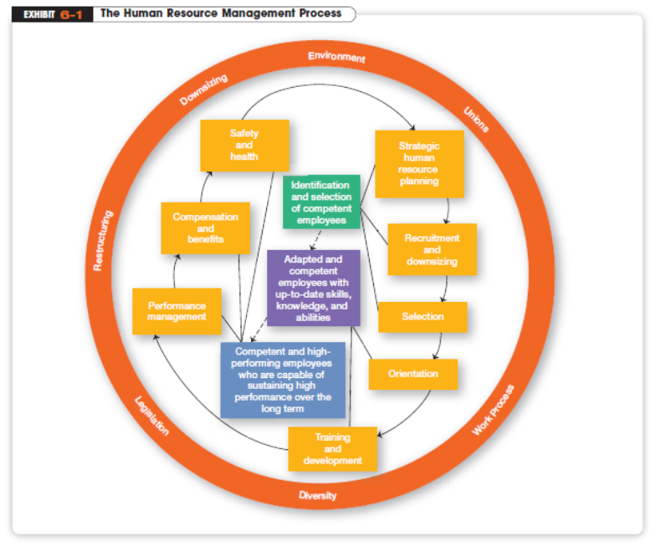

Org’s. strategic direction
Copyright ©2011 Pearson Education, Inc. Publishing as Prentice Hall.
6-4
Notes:
Notice in Exhibit 6-1 that the entire process is influenced by the external environment. Many of the factors introduced in Chapter 2 directly affect all management practices, but their effect is felt the most in managing the organization’s human resources, because whatever happens to an organization ultimately influences what happens to its employees

Slide 10

Employment Planning
Employment Planning
The process by which managers ensure they have the right numbers and kinds of people in the right places at the right time
Human Resource Inventory
A report listing important information about employees such as name, education, training, skills, languages spoken, and so forth.
Assessing current and future HR needs
Industry trends
KSA development plan
$10 B
Copyright ©2011 Pearson Education, Inc. Publishing as Prentice Hall.
6-8
Notes:
Employment planning is the process by which managers ensure that they have the right number and kinds of people in the right places at the right times, people who are capable of effectively and efficiently completing those tasks that will help the organization achieve its
overall goals. Employment planning, then, translates the organization’s mission and goals into an HR plan that will allow the organization to achieve those goals

Slide 11


Job Analysis
An assessment that defines jobs
and the behaviors necessary
to perform them (mean)
Job Description
A written statement that describes a job (how; why)
Job Specification
A written statement of the minimum qualifications that a person must possess to perform a given job successfully
Business leader
build and manage teams that engage customers in this dynamic environment.
Lead the people that help customers
Adaptable and flexible by nature, you’re composed
Business leader:
- Manage teams that engage customers
- Lead people that help clients
-Adaptable, composed …
for applicant; manager; lowers discrimination
6-9
Notes:
Business leader at Apple: job description:
build and manage the various teams that engage customers in this dynamic environment.
Lead the people that help customers learn new skills, get technical support
Adaptable and flexible by nature, you’re composed
Whereas the human resources inventory is concerned with telling management what individual employees can do, job analysis
is more fundamental. It’s typically a lengthy process, one in which workflows are analyzed and skills and behaviors that are necessary to perform jobs are identified.

Slide 12

Recruiting
Process of locating, identifying, and attracting capable applicants.
Based on the job analysis conducted, begin tracking down candidates for the business leader position
using: - private employment agencies
- temporary help services
- internal searches
Copyright ©2011 Pearson Education, Inc. Publishing as Prentice Hall.
Notes:
Once managers know their current staffing levels—whether understaffed or overstaffed—they can begin to do something
about it. If one or more vacancies exist, they can use the information gathered through job analysis to guide them in recruitment—that is, the process of locating, identifying, and attracting capable applicants.

Slide 13
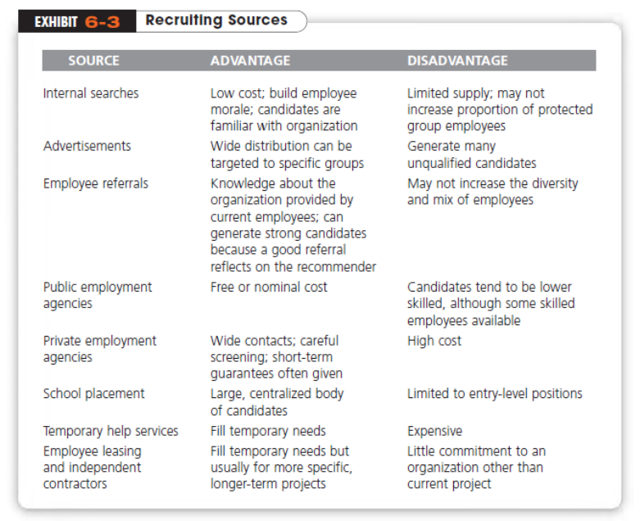
Apple referral program
“Pays to have friends”
What makes it work?
Interview; CS; TW; SM
Copyright ©2011 Pearson Education, Inc. Publishing as Prentice Hall.
6-11
Notes:
Applicants can be found by using several sources, including the Internet. Exhibit 6-3 offers some guidance. The source
that’s used should reflect the local labor market, the type or level of position, and the size of the organization.

Slide 14


Selection & Hiring
Once there is a pool of applicants
Selection Process
Screening job applicants to ensure that the most appropriate candidates are hired
prediction
Reliability
The degree to which a selection device measures the same thing consistently
effective: r=.7 ; inter-rater reliability
Validity: The proven relationship between a selection device and some relevant
criterion, e.g., tests are job related?;
Physical criteria?
high sales volume
6-13
Notes:
Once the recruiting effort has developed a pool of applicants, the next step in the HRM process is to determine who is best qualified for the job. In essence, then, the selection process is a prediction exercise:
It seeks to predict which applicants will be “successful” if hired; that is, who will perform well on the criteria the organization uses to evaluate its employees.

Slide 15
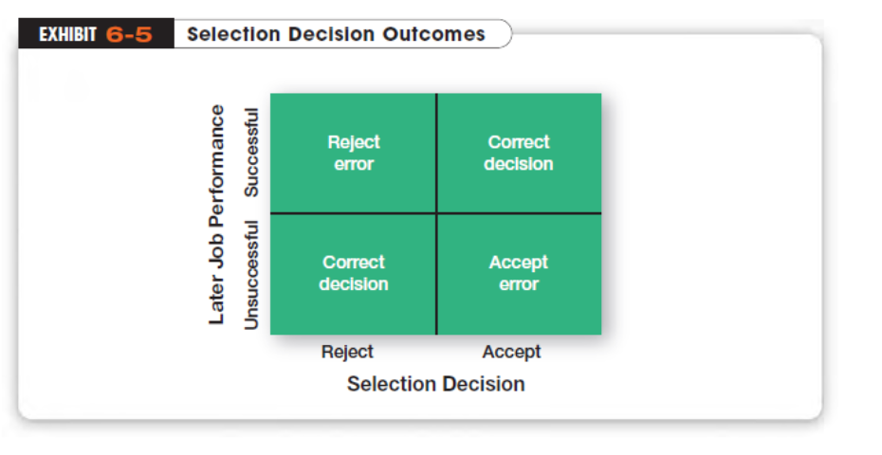
- 4 options:
Discrimination
charges
Training costs
Reliability
Validity
Copyright ©2011 Pearson Education, Inc. Publishing as Prentice Hall.
6-14
Notes:
Consider, for a moment, that any selection decision can result in four possible outcomes. As shown in Exhibit 6-5, two outcomes would indicate correct decisions, and two would indicate errors.

Slide 16


Pre-Employment Testing
To reduce decision errors
One criticism of written tests is that they
may measure characteristics which are not
related to job performance (IQ tests
& computer programmer performance
Performance-Simulation Tests
Selection devices based on actual job
behaviors
-Technical manual position
- Assessment Centers/ Mgt simulation
- Role play & interview – realistic client protest
- Structured interview
100 lines of code
Copyright ©2011 Pearson Education, Inc. Publishing as Prentice Hall.
6-15
Notes:
Managers can use a number of selection devices to reduce accept and reject errors. The best known
devices include written and performance-simulation tests and interviews

Slide 17
Getting Candidate to Accept Offer
Providing only details of positive aspects of a job may lead to satisfaction problems later.
Realistic Job Preview (RJP)
A preview of a job that provides both positive and negative information about the job and the company
- match expectations with job reality
work hours fluctuate; promotions
- hiring right people for the right job
- less resignations
Copyright ©2011 Pearson Education, Inc. Publishing as Prentice Hall.
6-16
Notes:
To increase job satisfaction among employees and reduce turnover, managers should consider a realistic job preview (RJP). An RJP includes both positive and negative information about the job and the company
Vi – avoid entry sh0ck…

Slide 18

How Are New Hires Introduced to the Organization?
Orientation
Introducing a new employee to the job and the organization (duties; PA; significance; policies).
Employee Training
A learning experience that seeks a relatively permanent change in employees by improving their ability to perform on the job: Flt.1549
Needs =>
Copyright ©2011 Pearson Education, Inc. Publishing as Prentice Hall.
6-17
Notes:
Once a job candidate has been selected, he or she needs to be introduced to the job and organization. This introduction is called orientation
Employee training is a learning experience that seeks a relatively permanent change in employees by improving their ability to perform on the job. Thus, training involves changing skills, knowledge, attitudes, or behavior

Slide 19
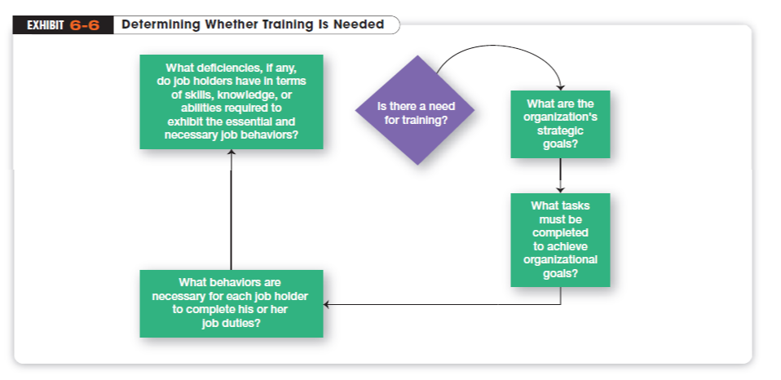

Signals:
productivity
accidents
effort?
Job redesign
New tech
e.g., MD screening
Copyright ©2011 Pearson Education, Inc. Publishing as Prentice Hall.
6-18
Notes:
The leading questions in Exhibit 6-6 suggest the kinds of signals that can warn a manager when training may be necessary. The more obvious ones are related directly to productivity

Slide 20
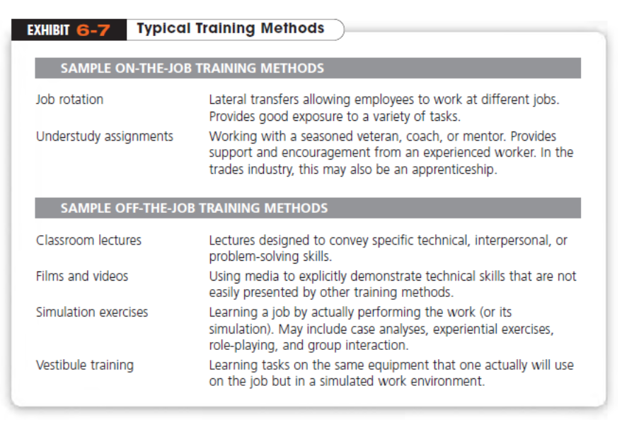

formal /
informal
Advantages? transferrable
Training Effective?
6-19
Notes:
Many different types of training methods are available. For the most part, we can classify them as on-the-job or off-the-job training. The more popular training methods are summarized in Exhibit 6-7.

Slide 21
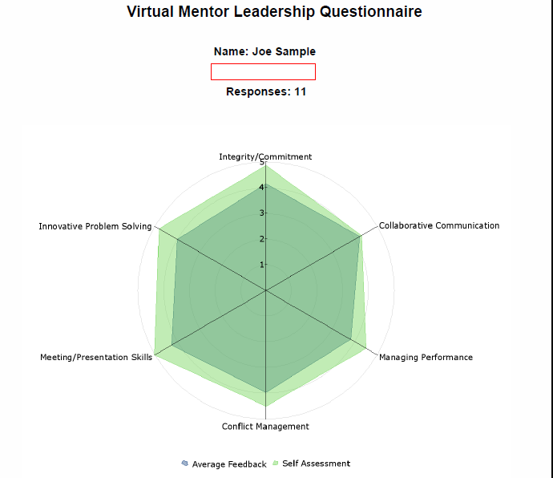

What Is a Performance Management System?
Performance Management System
A system that establishes performance standards that are used to evaluate employee performance (challenges in project work?)
360-degree appraisal
An appraisal device that seeks feedback from a variety of sources for the person being rated
Multi Source FB
90 %
Copyright ©2011 Pearson Education, Inc. Publishing as Prentice Hall.
6-20
Notes:
It’s important for managers to get their employees to achieve performance levels that the organization considers desirable. How do managers ensure that employees are performing as well as they’re supposed to? In organizations, the formal means of assessing the work of employees is through a systematic performance appraisal process.

Slide 22
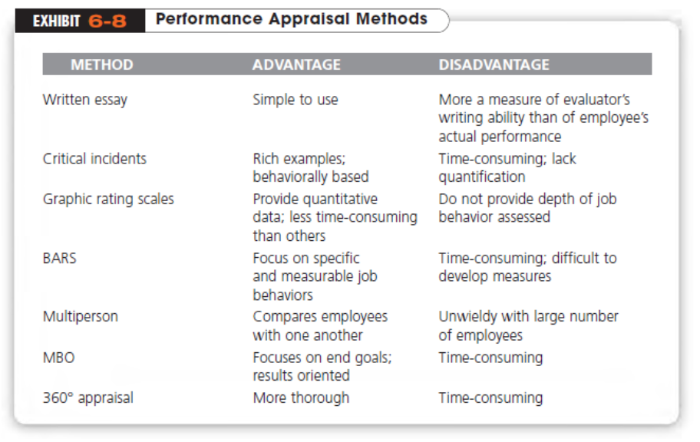
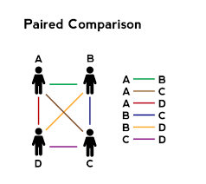
Copyright ©2011 Pearson Education, Inc. Publishing as Prentice Hall.
6-21
Notes:
We list specific appraisal techniques in Exhibit 6-8.
group (5;40)
individual
paired (S;W)
GE; Yahoo;
MS

Slide 23
Collaborative work in your teams
Anglo American South Africa – HBR Case on Canvas
1. Identify several Human Relations Themes in the case
2. What might be some Scientific Management ideas in the case?
3. Describe the recruitment process for the BLAST
program including:
3a. the various steps; the interviews; the selection criteria; the ranking;
3b. Describe whether there was a Realistic Job Preview – aligning applicant expectations with the company culture.
4. What evidence was there for Orientation training?
5. Discuss the performance appraisal.
We will get input from the teams later on during class.
Copyright ©2011 Pearson Education, Inc. Publishing as Prentice Hall.
After class, share your collaborative work on Google docs with zaronson@stevens.edu
6-17

